Slide 1

Automated Loan Approval System:
Enhancing Banking Efficiency through Data Science Jasper Umoffia

Slide 2
Problem & Solution
Challenges:
Traditional loan approval processes are time-consuming and prone to human error, leading to inefficiencies and delays.
Solution:
Implementing automation improves efficiency by streamlining workflows and enhances accuracy through advanced data science techniques, revolutionizing the loan approval paradigm.
Reduce Turnaround Time

Slide 3
Data Source
Source: The dataset was sourced from Kaggle (LOAN PREDICTION DATASET ).
Description: With 614 entries and 13 columns, including the target variable "Loan_Status," our goal is to predict whether a loan should be approved or declined based on diverse attributes like gender, income, and credit history.

Slide 4
Methodology
Dependencies & Tools:
Will employ essential data science tools, including Pandas, Scikit-learn, Matplotlib, Seaborn, and XGBoost for data handling, visualization, and machine learning.
Machine Learning Methods:
Will utilize a variety of algorithms:
GaussianNB
SVC with Grid Search CV
XGBoost classifier
Decision Tree using Randomized Search
Random Forest using Randomized Search
Model Evaluation:
Will incorporate loss functions to assess model performance during development (Accuracy, Recall, Precision and F1- Score).

Slide 5
Expected Outcome
Expectations:
Anticipate a transformative impact on the loan approval process through automation, leading to enhanced efficiency and reduced processing time.
Envision improved accuracy in decision-making, resulting in a more reliable and fair system for applicants.
Enthusiasm:
Excited about the opportunity to apply data science methodologies to real-world challenges in the financial sector.
Eager to contribute to the advancement of automated systems that can positively influence business operations and customer experiences.

Slide 6
Data Exploration
Loan_ID | Gender | Married | Dependents | Education | Self_Employed | ApplicantIncome | CoapplicantIncome | LoanAmount | Loan_Amount_Term | Credit_History | Property_Area | Loan_Status
0 | LP001002 | Male | No | 0 | Graduate | No | 5849 | 0.0 | NaN | 360.0 | 1.0 | Urban | Y
1 | LP001003 | Male | Yes | 1 | Graduate | No | 4583 | 1508.0 | 128.0 | 360.0 | 1.0 | Rural | N
2 | LP001005 | Male | Yes | 0 | Graduate | Yes | 3000 | 0.0 | 66.0 | 360.0 | 1.0 | Urban | Y
3 | LP001006 | Male | Yes | 0 | Not Graduate | No | 2583 | 2358.0 | 120.0 | 360.0 | 1.0 | Urban | Y
4 | LP001008 | Male | No | 0 | Graduate | No | 6000 | 0.0 | 141.0 | 360.0 | 1.0 | Urban | Y
Data columns (total 13 columns):
# Column Non-Null Count
--- ------ --------------
0 Loan_ID 614 non-null
1 Gender 601 non-null
2 Married 611 non-null
3 Dependents 599 non-null
4 Education 614 non-null
5 Self_Employed 582 non-null
6 ApplicantIncome 614 non-null
7 CoapplicantIncome 614 non-null
8 LoanAmount 592 non-null
9 Loan_Amount_Term 600 non-null
10 Credit_History 564 non-null
11 Property_Area 614 non-null
12 Loan_Status 614 non-null

Slide 7
Data Exploration Cont.: Overview of Key Financial Statistics

Slide 8
Data Exploration Cont.: Handling missing values
Imputation of Missing Values:
Selected columns: LoanAmount, Loan_Amount_Term, Credit_History
Imputation Method: Mean imputation
Result: Missing values replaced with respective column means, ensuring dataset completeness and preserving statistical characteristics.

Slide 9
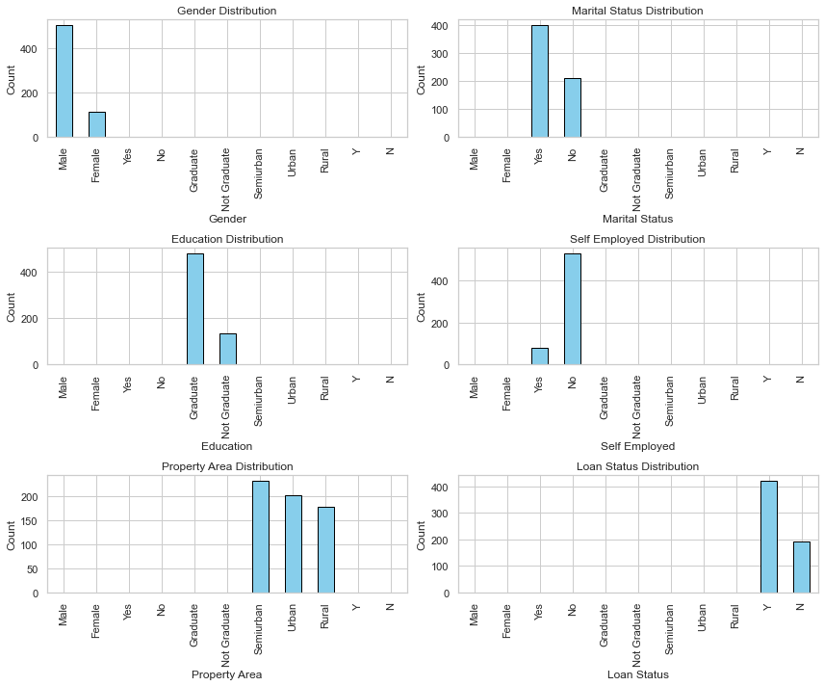
Data Exploration Cont.: Feature Classification

Slide 10
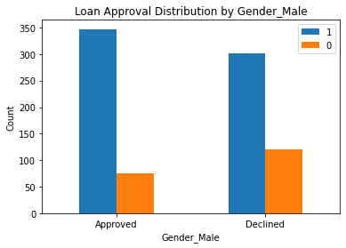

Slide 11
Data Exploration Cont.: Balancing Imbalanced Features: Encoding and SMOTE
Achieve balance in imbalanced features through encoding and SMOTE.
1. Ordinal encoding for 'Dependents' (non-binary classes).
2. One-hot encoding for other categorical features (binary classes).
Why Ordinal Encoding?
Maintains order for non-binary classes like 'Dependents’ ('0', '1', '2', '3+').
Next Step:
Apply Synthetic Minority Over-sampling Technique (SMOTE) for overall balance.

Slide 12
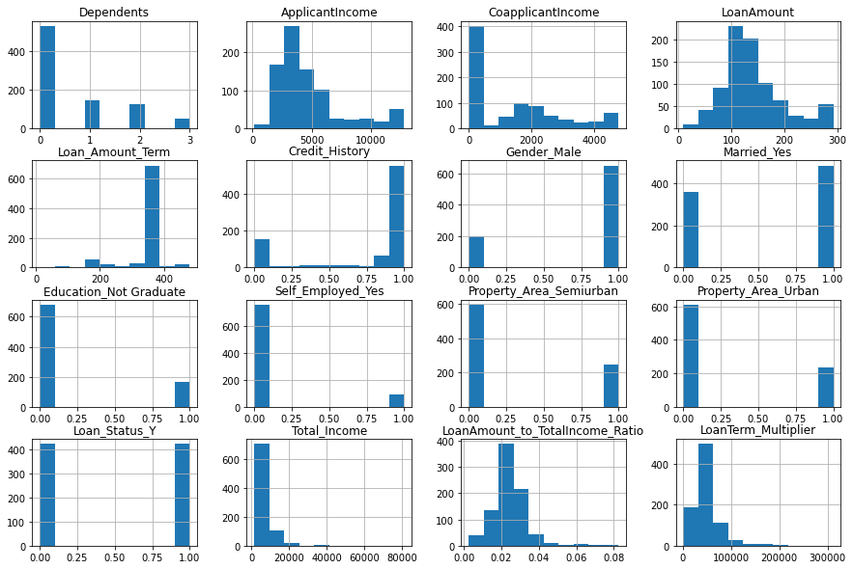
Feature Distribution

Slide 13
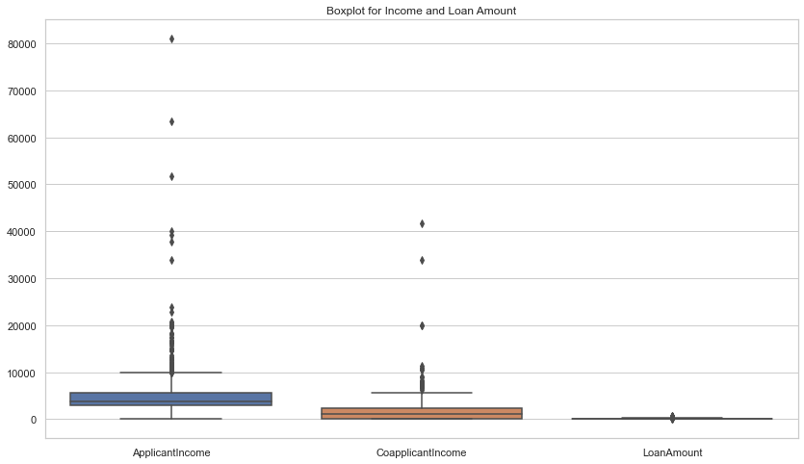
Preprocessing Check for outliers

Slide 14
Preprocessing: Addressing Outliers: Capping Values at the 95th Percentile
Ensure robustness in data preprocessing by addressing outliers.
Why Cap Outliers at 95th Percentile?
1. Maintaining Data Integrity:
Preserves most of the dataset, avoiding extreme values' influence.
Mitigates the impact of outliers on statistical measures.
2. Balancing Outlier Handling:
A balance between outlier removal and data preservation.
Allows for a more nuanced approach, retaining valuable information.
3. Statistical Significance:
The 95th percentile is a common threshold in statistical practice.
Strikes a balance between extreme values and overall data distribution.

Slide 15
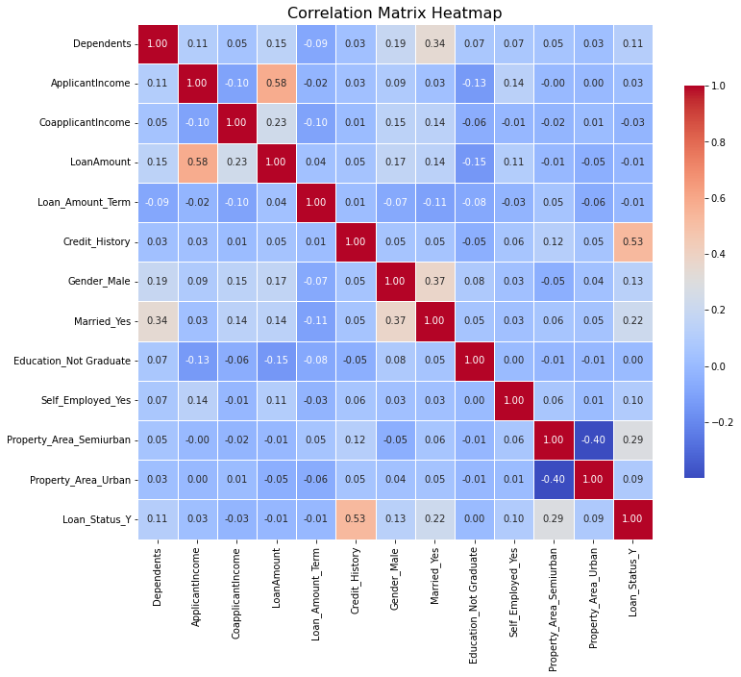
Display the correlation matrix

Slide 16
Preprocessing: Model Selection and Scaling Strategy
Model Selection:
Chosen models: XGBoost, Decision Trees, and Random Forests for capturing complex patterns.
Hyperparameter Tuning:
Techniques: Grid Search Cross-Validation and Randomized Search.
Optimizes model parameters, tailoring algorithms to dataset characteristics.
Scaling Consideration:
Algos (XGBoost, Decision Trees, Random Forest) handle scaling internally.
Evaluation of model performance with and without scaling for optimization.

Slide 17
Best Model Performance Analysis XGBoostClassifier
Precision (0.817):
The XGBoostClassifier, applied to scaled data, exhibited a precision of approximately 81.7% indicating it’s ability to highly minimize the amount of false positives.
The model demonstrates a highly accurate identification of loans that should be approved.
Recall (0.905):
The XGBoostClassifier captured about 90.5% of the actual loan approvals, showcasing an excellent ability to identify majority of legitimate loan requests.
The higher recall further minimizes the chances of missing opportunities to approve eligible loans.

Slide 18
Best Model Performance Analysis XGBoostClassifier
Accuracy (0.852):
The overall accuracy of the XGBoostClassifier on scaled data is approximately 85.2%, indicating a high level of correctness in predictions across instances.
While accuracy is important, it's crucial to assess precision and recall alongside accuracy, especially in scenarios with imbalanced datasets.
F1-Score (0.859):
The F-Score for the XGBoostClassifier is 85.9%, a balanced metric considering both precision and recall.
This high F-Score reflects the model's effectiveness in accurately identifying loan approvals while minimizing missed opportunities.

Slide 19
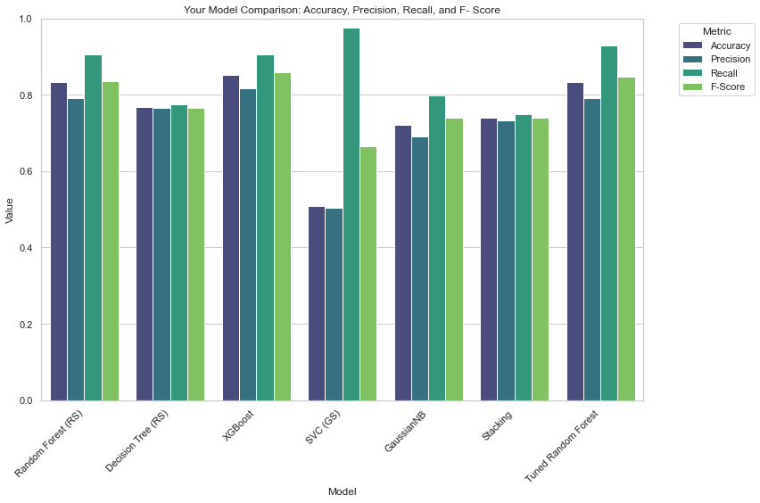

Slide 20
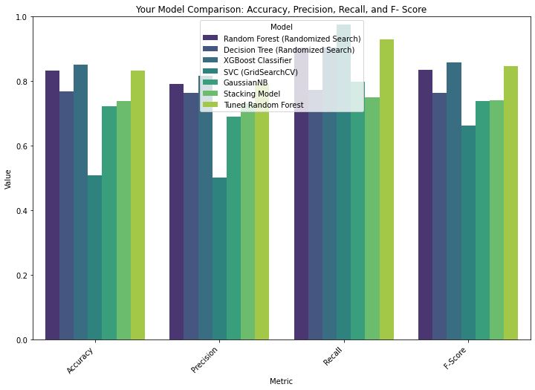

Slide 21
Recommendation
Given the significance of minimizing both false positives and false negatives in loan approval decisions, the superior performance of the XGBoostClassifier makes it the recommended algorithm.
XGBoost provides a robust and well-balanced solution for the specific challenges posed by loan prediction scenarios.

Slide 22
Benchmark for Finance Industry
In the finance industry, achieving a balanced precision and recall is crucial to minimize both the risk of approving potentially problematic loans (false positives) and missing out on legitimate approvals (false negatives).
A recommended benchmark could be an F1-Score above 0.80, indicating a strong balance between precision and recall. This benchmark ensures a model's effectiveness in accurately identifying approved loans while avoiding excessive false positives or negatives.
The XGBoost Classifier, with an F1-Score of 0.859, surpasses this benchmark, making it a reliable choice for loan approval systems in the finance industry.

Slide 23

Thank you

